Slide 1
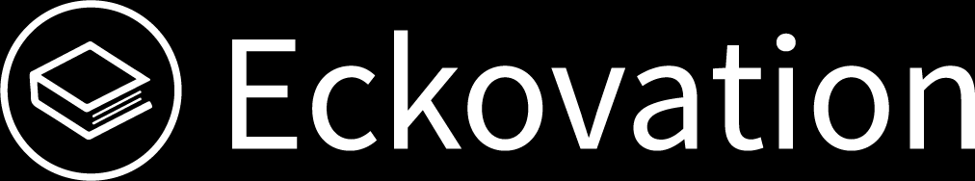

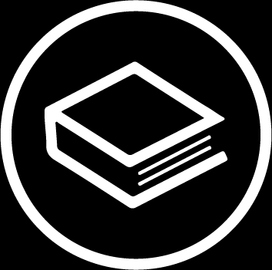
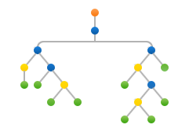
Machine Learning
Decision Tree
(Python Implementation)

Slide 2
Decision Tree (Implementation)
Data-set Description :
Title : Balance Scale Weight & Distance Database
Number of Instances : 625 (49 balanced, 288 left, 288 right)
Number of Attributes : 4 (numeric) + class name = 5
Attribute Information :
Class Name (Target variable): 3
L [balance scale tip to the left]
B [balance scale be balanced]
R [balance scale tip to the right]
Left-Weight : 5 (1, 2, 3, 4, 5)
Left-Distance : 5 (1, 2, 3, 4, 5)
Right-Weight : 5 (1, 2, 3, 4, 5)
Right-Distance : 5 (1, 2, 3, 4, 5)
Missing Attribute Values : None
Class Distribution :
46.08 percent are L
07.84 percent are B
46.08 percent are R

Slide 3
Decision Tree (Implementation)
Used Python Packages :
sklearn :
In python, sklearn is a machine learning package which include a lot of ML algorithms.
Here, we are using some of its modules like train_test_split, DecisionTreeClassifier and accuracy_score.
NumPy :
It is a numeric python module which provides fast maths functions for calculations.
It is used to read data in numpy arrays and for manipulation purpose.
Pandas :
Used to read and write different files.
Data manipulation can be done easily with dataframes.

Slide 4
Decision Tree (Implementation)
Packages Import :
We need to import the packages into our local system in order to run the program.
# Importing the required packages
import numpy as np
import pandas as pd
from sklearn.metrics import confusion_matrix
from sklearn.cross_validation import train_test_split
from sklearn.tree import DecisionTreeClassifier
from sklearn.metrics import accuracy_score
from sklearn.metrics import classification_report
This will import all the required packages into our local system.

Slide 5
Decision Tree (Implementation)
Pseudocode :
Find the best attribute and place it on the root node of the tree.
Now, split the training set of the dataset into subsets. While making the subset make sure that each subset of training dataset should have the same value for an attribute.
Find leaf nodes in all branches by repeating steps 1 and 2 on each subset.

Slide 6
Decision Tree (Implementation)
While implementing the decision tree we will go through the following two phases:
Building Phase
Preprocess the dataset.
Split the dataset from train and test using Python sklearn package.
Train the classifier.
Operational Phase
Make predictions.
Calculate the accuracy.

Slide 7
Decision Tree (Implementation)
Data Import :
To import and manipulate the data we are using the pandas package provided in python.
Here, we are using a URL which is directly fetching the dataset from the UCI site no need to download the dataset. For this, you need an active internet connection.
As the dataset is separated by “,” so we have to pass the sep parameter’s value as “,”.
Another thing to notice is that the dataset doesn’t contain the header so we will pass the Header parameter’s value as none.
If we will not pass the header parameter then it will consider the first line of the dataset as the header.
# Function importing Dataset
def importdata():
balance_data = pd.read_csv('https://archive.ics.uci.edu/ml/machine-learning-'+
'databases/balance-scale/balance-scale.data’, sep= ',', header = None)

Slide 8
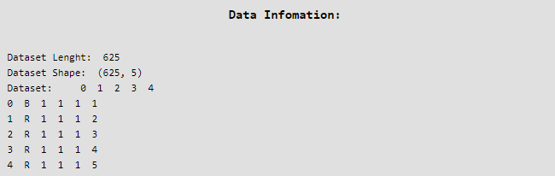
Decision Tree (Implementation)
Printing the dataset :
[in: ]
# Printing the dataset shape
print ("Dataset Length: ", len(balance_data))
print ("Dataset Shape: ", balance_data.shape)
# Printing the dataset obseravtions
print ("Dataset: ",balance_data.head())
return balance_data
[out: ]

Slide 9
Decision Tree (Implementation)
Data Slicing :
Before training the model we have to split the dataset into the training and testing dataset.
To split the dataset for training and testing we are using the sklearn module train_test_split.
First of all we have to separate the target variable from the attributes in the dataset.
X = balance_data.values[:, 1:5]
Y = balance_data.values[:,0]
Above are the lines from the code which separate the dataset. The variable X contains the attributes while the variable Y contains the target variable of the dataset.
Next step is to split the dataset for training and testing purpose.
X_train, X_test, y_train, y_test = train_test_split( X, Y, test_size = 0.3, random_state = 100)
Above line split the dataset for training and testing. As we are spliting the dataset in a ratio of 70:30 between training and testing so we are pass test_size parameter’s value as 0.3.
random_state variable is a pseudo-random number generator state used for random sampling.

Slide 10
Decision Tree (Implementation)
Data Slicing :
# Function to split the dataset
def splitdataset(balance_data):
# Seperating the target variable
X = balance_data.values[:, 1:5]
Y = balance_data.values[:, 0]
# Spliting the dataset into train and test
X_train, X_test, y_train, y_test = train_test_split(
X, Y, test_size = 0.3, random_state = 100)
return X, Y, X_train, X_test, y_train, y_test

